Slide 1


Technology Training on AWS, Spark, and Data Engineering
Sarvik Gwala's internship overview, focusing on data engineering with AWS, Hive, and Spark. The role involves ETL, building data pipelines, and optimizing SQL queries.
by Himanshu

Slide 2
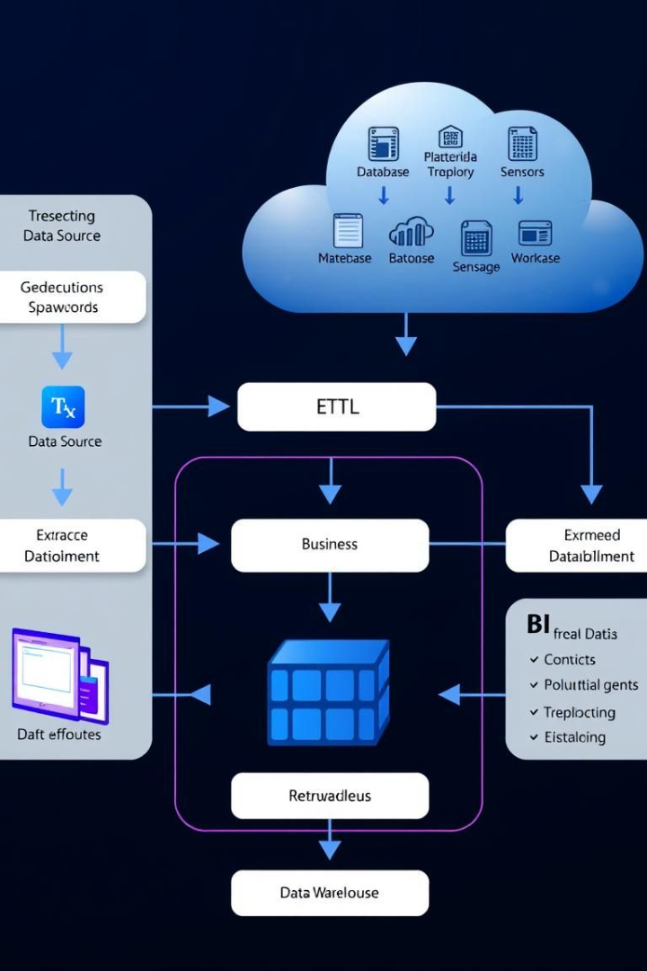
Internship Objectives
1
Process IoT Data
Use Apache Spark & Hive for large-scale IoT data processing.
2
Optimize Data Warehouse
Design an optimized cloud-based data warehouse.
3
Improve Query Performance
Enhance data retrieval efficiency.
4
Automate ETL
Automate ETL processes for real-time data ingestion.

Slide 3





Technologies & Tools
Programming
Big Data
Cloud Platform
Database Management
Python, SQL
Apache Spark, Apache Hive
AWS (S3, Redshift, Glue, EMR)
SQL, NoSQL (MongoDB, PostgreSQL)
Key technologies include Python, SQL, Apache Spark, Hive, and AWS services. Airflow is used for workflow orchestration.

Slide 4
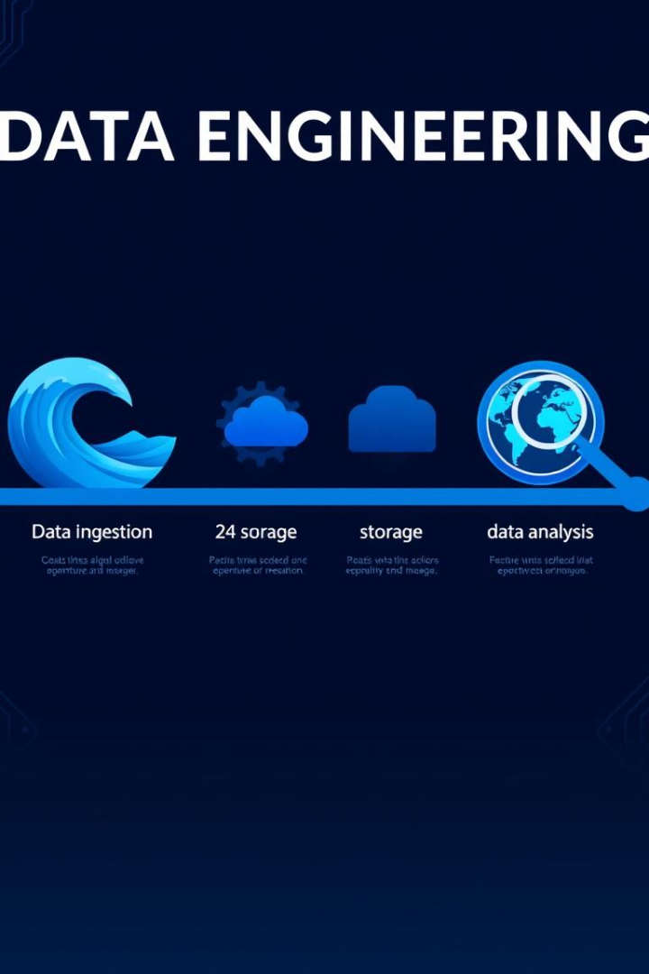
Project Progress
1
SQL & Python Foundations
Complex queries and stored procedures implemented.
2
Data Modeling & Warehousing
Designed star and snowflake schemas; deployed AWS Redshift warehouse.
3
ETL Pipeline Development
Writing PySpark scripts for batch processing.
4
Spark & Hive Integration
Setting up Spark jobs for distributed data processing.

Slide 5
Challenges Faced & Solutions
Slow SQL Query Execution
Managing Large IoT Data in Hive
Real-time Processing Latency
Indexed columns, optimized joins.
Partitioning & Bucketing strategies.
Stream processing with Spark Structured Streaming.

Slide 6
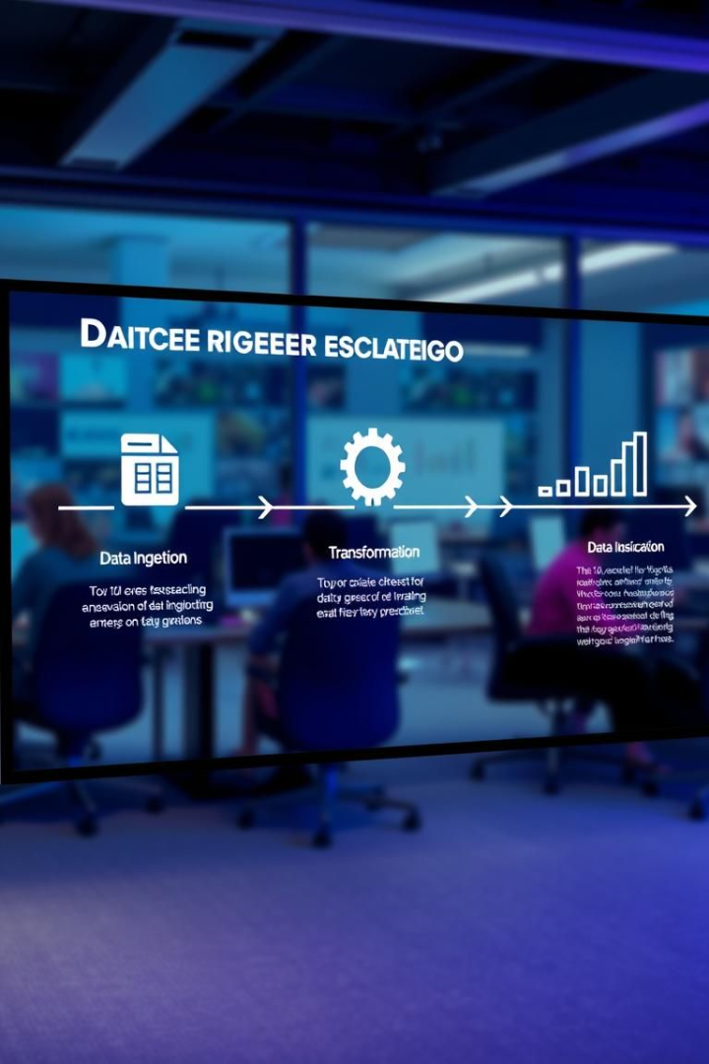




Next Steps & Future Plans
IoT Data Processing & Analytics
Finalize data pipeline using AWS S3, Kafka, and Spark.
ETL Pipeline for Cloud Data Warehousing
Complete data transformation scripts using PySpark & SQL.
Real-time Log Monitoring & Alerting
Deploy Kafka + Spark Streaming to process real-time log data.
Final Integration & Deployment
Conduct load testing & performance tuning.

Slide 7

Conclusion & Learnings
Hands-on Experience
Proficiency
Proficient in Spark, Hive, SQL, and AWS.
Gained experience in big data engineering.
Optimized Workflows
Optimized real-time data processing workflows.
Future improvements: Enhance ML-based analytics for IoT data. Optimize cloud costs by using serverless architectures.

Slide 8

Thank You

